Slide 1
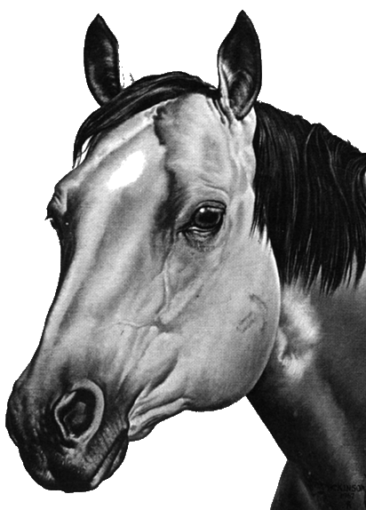
The Foundation Quarter Horse Registry
March 2026

Slide 2
Making More History
March 1995
At a meeting in Akron, Colorado on Monday and Tuesday, December 19 and 20 1994, another entry was made in the history book for foundation horses and breeders. A preliminary meeting was held concerning the creation of a Foundation Quarter Horse Registry. Many breeders in the last few years have called or written asking what can we do to save the old bloodlines. Most felt what we needed was a registry dedicated totally to preserving and perpetuating the old Quarter Horse families.
Invitations were issued to those who had expressed a real and valid interest in coming and being a part in finding answers and solutions. Breeders in attendance were from Montana, South Dakota, Nevada, Colorado and Texas. Because of different reasons several others were unable to attend but expressed their blessing in beginning the “round-Up”.
Monday afternoon was spent getting acquainted, talking horses, visiting, and seeing the library of Cow Horse Books. Monday evening films on some of the old horses were shown and a time of discussion was held. Dillon Shook addressed those in attendance and spelled out these motivating reasons and goals for creating a Foundation Registry. First: to preserve, promote, and perpetuate the Foundation Quarter Horse (our Kind of horse) the horse we care about. Second: to return to a breeder-controlled Registry. Third: we are tired of escalating fees and no representation. Fourth: to fill the need for breeders in record keeping of bloodlines, advertising
shows, sales, and whatever needs to be done in accomplishing these goals. Its true today, “Horses are like people, there are lots of ‘em, but only a few good ones.” These are the animals we are interested in. Stuart Hamblin said, “If I don’t toot my own horn, it just gets to quiet.” No longer will we be the quiet, silent minority. It’s time to saddle up and do some ridin’ on the right trails!
On Tuesday the meeting was moved to Sterling, Colorado at the Ramada Inn. The meeting was opened by Dillon Shook and was in session some six hours. As a result of this meeting, it was agreed to incorporate in the state of Colorado as “The Foundation Quarter Horse Registry LTD.” Elected as officers were President, Jerry Power Iving, Texas; Vice President Gail Zscheile Lamoille, Nevada; Secretary/Treasurer, Dillon Shook, Akron, Co.
Trails of the Foundation Quarter Horse

Slide 3
Advisory Board
Vicki Austin
Vicksburg, MI
269.649.1106 fqhr@gtoast.net
Scott Perry
West Salem, WI
Scott@bahrelectricllc.com
Rhonda Broekema
Schoolcraft, MI
269.207.5595
RhondaEMS@aol.com
Brandon Smith
Colony, OK smithquarterhorses75@hotmail.com
Mary Kahn
Rock Port, MO
64482 660.528.1332 jenghis@aol.com

Slide 4
Judges Committee
Chairman : Robert Walton Rosebush,MI 48878 989.621.2078
Eddie Smith
Fletcher, NC
828.423.9771
Trevor Walton
Riverdale, MI
989.465.2085

Slide 5
F.Q.H.R. UPDATES
New white line rule
Added 3-5 Ranch Cutting
Changed wording for silver
Added 2 Reining Patterns
Added 2 Ranch Riding patterns.
Added LMT JR Youth Classes (handy ranch and Pleasure)

Slide 6
White Line Rule Update
AFFILIATE GUIDELINES Any FQHR member having an interest in the Foundation Quarter Horse Registry may request and submit an application to start an FQHR Affiliate in their area. Upon receipt and review of said application, the FQHR office may grant or deny continuation of the affiliate process. If permission is granted, the applicant must then select and submit to the FQHR office a meeting place, location with directions, date and time, along with two contact numbers. FQHR will provide a list of past and current members in the designated area to the applicant so they may announce the first meeting. A nominating committee should be selected at this meeting. A second meeting should then be held to elect officers. Once officers are elected and documentation is sent to the home office, said affiliate will be recognized as an official FQHR Affiliate. Qualifying affiliates shall pay an annual fee of fifty dollars ($50.00) which represents a membership fee, to the FQHR home office, on January 1 of each calendar year. The fee will be considered delinquent if not paid within sixty (60) days. Any new affiliate’s fee will be waived for the first year. In order to retain the designation of FQHR Affiliate, each affiliate MUST:
- Pay an annual fee within 60 days of Jan 1 ($50.00). -. - Provide FQHR with a copy of affiliate by-laws. - Hold annual election of officers (preferably between November - March). - Provide FQHR with an updated list of officers. All officers must be current FQHR members. A person may serve as an officer of one FQHR affiliate only. - Provide FQHR with copies of newsletter (if printed by affiliate). - Provide FQHR with results from all approved shows or events as required. - Conduct affairs in compliance with affiliate by-laws as well as the by-laws of FQHR as outlined in the Foundation Quarter Horse Registry Rulebook. - Each affiliate is responsible for the affairs of its own affiliate and FQHR will not be held liable or accountable for internal differences. - Any affiliate found not in compliance with all of the above rules as of April 1 of each year, will be denied membership renewal until the above rules have been satisfied.

Slide 7
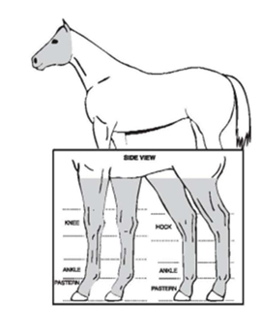

Slide 8
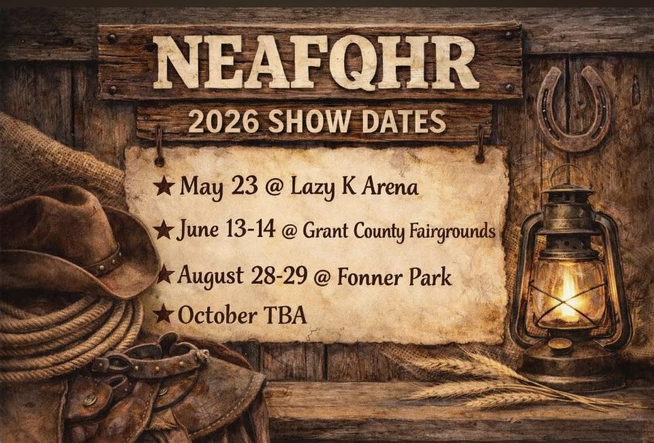

Slide 9
3-5 Ranch Cutting
RANCH CUTTING (3 min. – 90 sec warning) Open/Amateur/3-5/Novice/Youth/Prime. To be judged on a horse’s smoothness, cow sense and natural ability to read and work a cow. Horse should display lightness of handle and quietness in the herd. Settling the herd is permitted but not by the first exhibitor in the class. - Minimum number of cattle in the herd will be ten (10) to be located at one end of the arena - A pen with gate (when available) and wing located on the fence line, size and degree of difficulty option of judge - All cattle should be clearly marked with numbers. However, it is permissible to use more than one cow
with the same number if the cattle are different (red vs. black). This may be done in situations where an odd number of entries are in the class (11 vs. 10). In extenuating circumstances only non-numbered cattle may be used however, the judge should make every effort to ensure that no rider is given an advantage or disadvantage due to the way cattle are identified. - There is a 3-minute time limit starting from the time the cow’s number is called. A timeline at the middle of the arena should be designated. The cow number (or other identification) should be called when the rider crosses the line. The object will be to cut one cow from the herd and work it with the assistance of two turn- back riders. (Two herd holders may be used but only for the purpose of keeping the cattle centered in the arena. Once the cow is separated from the herd, they should not assist the rider being judged other than verbally. Noise directed at the cattle by the herd holders is not allowed. - Once the cow is clearly separated from the herd a 5 pt penalty will be charged if the cow re-enters the herd (lost). On the second occurrence, a 2nd 5 pt. penalty will be assessed, and the judge will signal the rider via whistle to stop work. This will not be cause for dis- qualification but a rider that loses a cow twice should not place over a rider that does not. The rider must drive the cow into the pen - close the gate if there is one. Failure to will also result in a 5-pt. penalty and the rider cannot place over one that does pen the cow. - A signal whistle will be blown at 90 seconds and at conclusion of 3 minutes - Scoring will be on a basis of 0-80 Penalties - Excessive help by herd holders or turn back riders -5 pts per incident - Allowing cow to return to the herd after it is clearly cut - 5 pts per incident - Failure to pen the cow within the time limit - 5 pts - Blatant disobedience Excessive spurring - 3 pts - Biting, striking, or kicking a cow - 3 pts - Loss of working advantage by more than 1 horse length - 1 pt. per incident - Gaping mouth when reined - 1pt - DQ Turn tail to cow, fall to ground of horse, rider or additional cattle in the pen,
Credits - Quiet in the herd and smoothness of cut - Degree of difficulty - Time spent working - Driving and controlling cow Horse will not be penalized for reining during cutting portion but should display horse’s natural cow ability in controlling and driving the cow. The judge will use and post the FQHR judges score sheet. All helping horses must be FQHR registered and all helpers must be FQHR members in Ranch Cutting. A waiver may be requested from FQHR. The show committee should provide a pen with a 6 to 8 foot closeable gate or a wing of no more than 12 feet. If so desired, the fence can serve as the wing

Slide 10
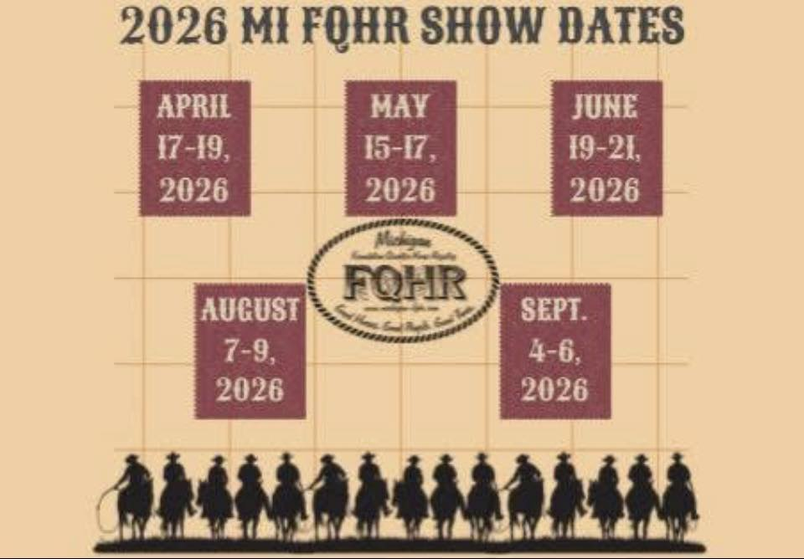

Slide 11
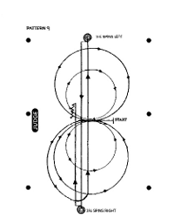
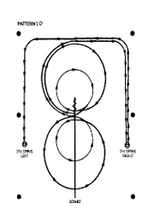
New Reining Patterns
Pattern 9
Trot to center of arena. Start pattern facing the judge
Begin on the left lead two circles first big and fast, second small and slow. Change leads in center of arena
Two circle to the right. First big and fast, second small and slow.
Continue around end of arena without breaking gate or changing leads run down center of arena past 3rd marker stop
Complete 3 ½ spins to the left
Run down center of arena past end marker and stop.
Complete 3 ½ spins to the right
Run down center of arena past middle marker , stop back 10 ft. Pause to complete pattern
Pattern 10
Start at end of arena. Run done the middle of arena past center marker back 10 steps. Turn ¼ turn left.
Beginning on the right lead complete 2 circles to the right. The first on large and fast the second small and slow. Change leads in center of arena.
Complete 2 circles to the left, first large and fast, second small and slow, change leads in center of arena.
Continue around end of arena without breaking gate or changing leads, run down the side ( approximately 20 feet from fence) past center marker and stop
Complete 3 ½ spins to right
Continue back down side and end of arena to other side and stop
Complete 3 ½ spins to left. Pause to complete pattern

Slide 12
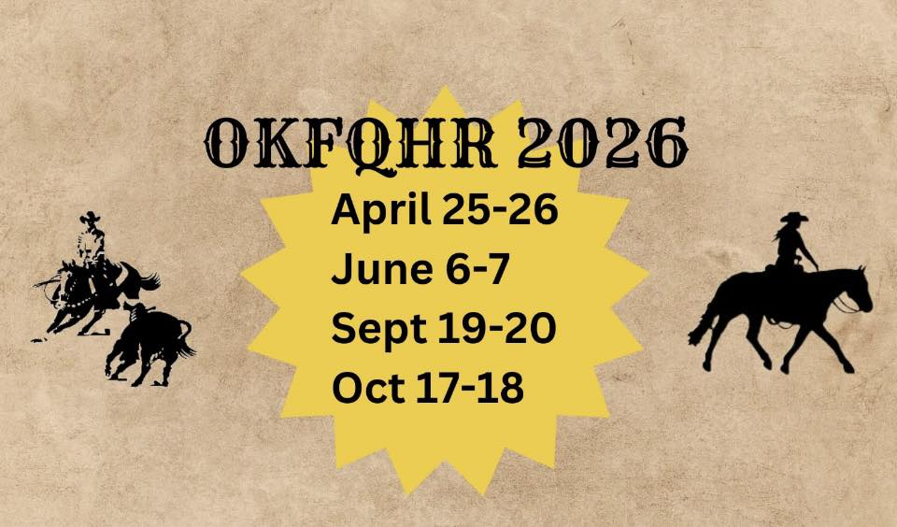

Slide 13
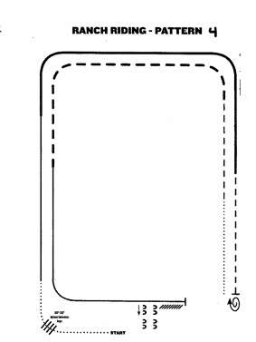
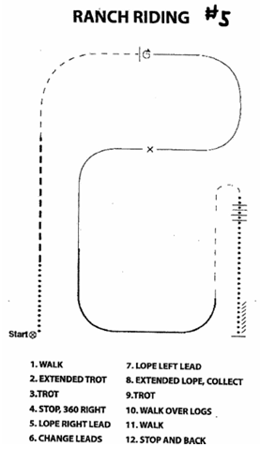
New Ranch Riding Patterns
Walk
Walk over logs
Lope right lead
Extended lope right lead
Trot
Stop. 1 ½ turn right
7) Walk
8) Trot
9) Extended trot
10) Lope left lead
11) Stop and back
12) Side pass right.

Slide 14
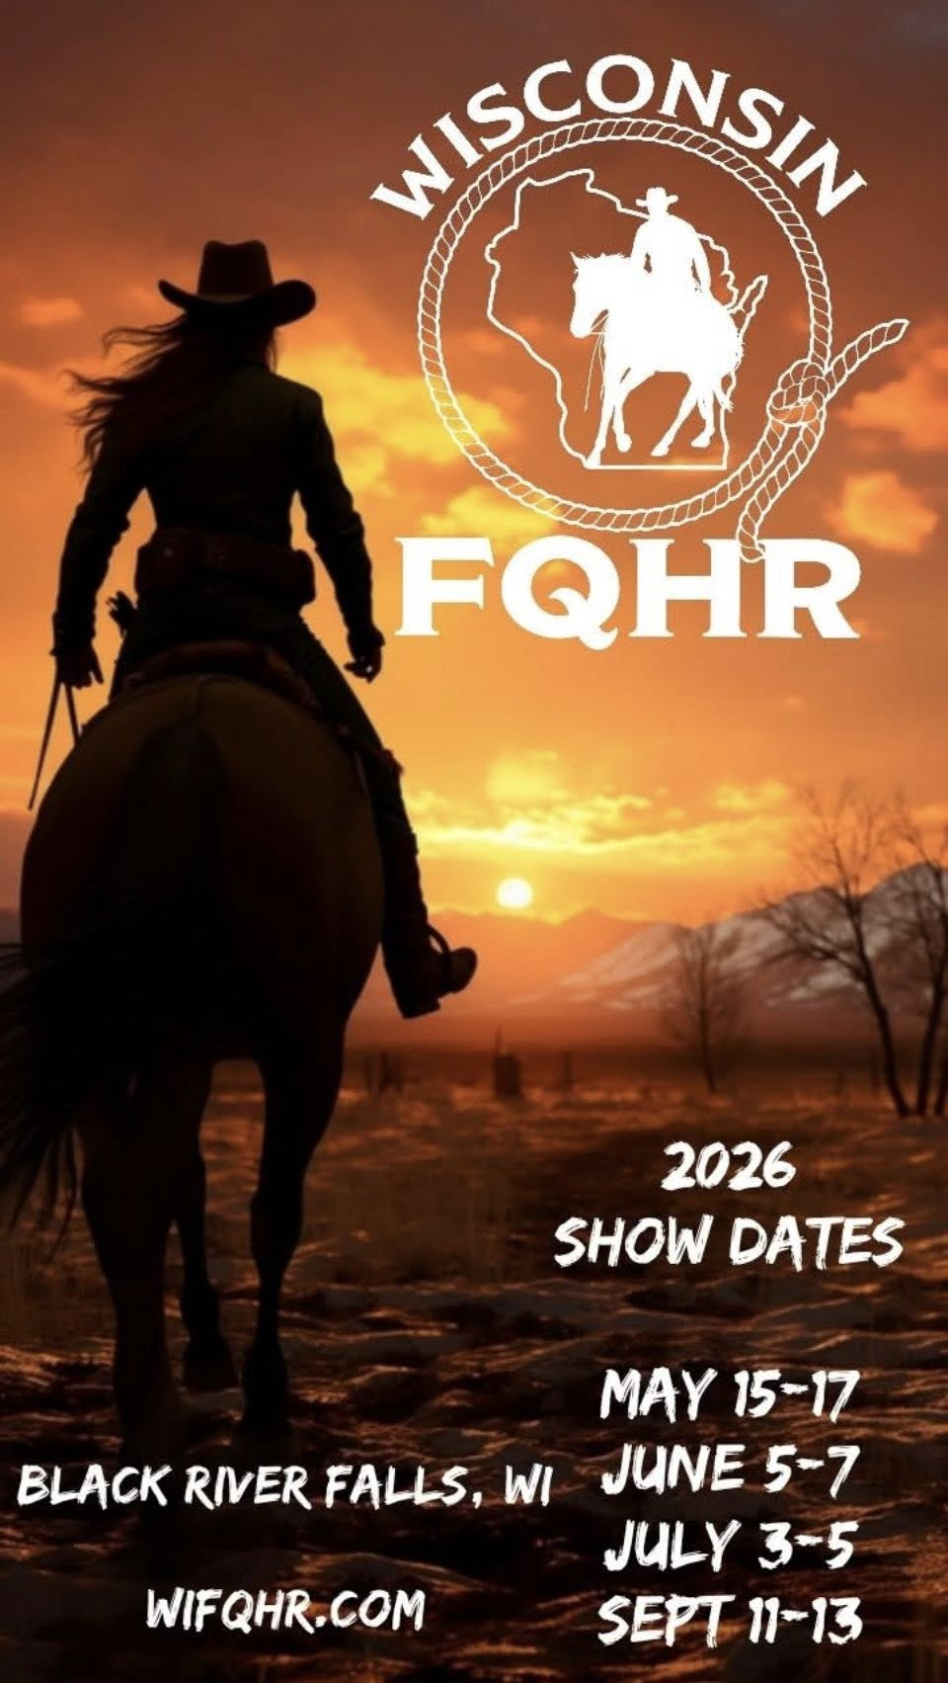

Slide 15
LMT JR YOUTH HANDY RANCH
The judge may not give verbal instructions to anyone unless all class participants are given the same opportunity. When classes are being run at will, it is inappropriate to address any exhibitor. All changes to patterns must be posted prior to the start of the class and continuously announced during the class. This class will be judged on the performance of the horse at the walk and trot only, performance navigating obstacles, response to the rider, and intelligence. Judges may also establish a time limit or add or take away points for efficiently working the pattern or taking too long to work the pattern. Judge will select two tie breakers. The scoring system will use the + - system with 70 being the average. Patterns should be designed such that at least once in the pattern horses will be required to demonstrate a walk (minimum 30 ft.) jog (minimum 30 ft). A minimum of three (3) obstacles and a maximum of five (5) will be used; combinations of two or more obstacles are permissible. All obstacles must meet the approval of the judge. In the event an obstacle is damaged and can no longer be used, that obstacle shall be removed from the course and all previous scores on that obstacle will be deducted from the judge’s score sheets.
Once a horse has refused an obstacle 3 times, the judge shall whistle that person off and score that obstacle a zero (0). The judge shall select a 1st and 2nd tie breaker. There will be no mandatory obstacles for the Limited exhibitors. Limited exhibitors will NOT work the gate, load into a trailer, drag a log or jump obstacles. They may rope the stationary steer, hobble or ground tie, go over brush, logs, convey items from one point to another. Additional obstacles may be used but should be similar to what would be encountered on the trail or in normal ranch work. The judges has the right and duty to alter the course in any manner or remove any obstacle deemed unsafe. All courses and obstacles are to be constructed with safety in mind so as to eliminate any possible accidents. It is permissible to change the rein hand to work an obstacle. Obstacles with a potential slick surface should be negotiated at the walk only. The pattern starts with a base of 70 points using the + - system. After deducting all faults from a maneuver, the judge should evaluate the execution of the pattern and the horse’s overall performance; credit should db given for smoothness, finesse, attitude, quickness and authority of performing various maneuvers. Penalties Penalties should be deducted from the obstacle score. But in no case can the sum of the penalties and the quality score by less than zero. - 5 Points: Blatant Disobedience (bucking, kicking, rearing), failure to change gaits when required or dropping an obstacle (slicker), stepping outside or off of an obstacle with two or more feet, failure to attempt an obstacle, working an obstacle from the wrong direction, turning the wrong way, 3rd refusal on the same obstacle. - 3 points: 1st refusal on an obstacle, 2nd refusal on the same obstacle (total -6 points), break of gait at walk/jog, stepping outside of or off an obstacle with one foot. - 1 point: Hitting or moving an obstacle such as a log in a trot, sidepass or back through, break of gait at walk/jog. - ½ point: Hitting/ticking an obstacle but not moving it. DQ
- Head carried with tips of ears below the withers for more than 3 strides at any gait unless working an obstacle. - Going off course - Attempting an obstacle in the arena not called for in the pattern

Slide 16
LMT JR YOUTH PLEASURE (WALK/TROT)
(Junior youth 13 and under) exhibitors in the limited classes may only show in the Limited Youth Ranch Pleasure and Limited Youth Handy Ranch class Horses are to be shown at a walk and jog only. All reverses to be performed toward the center. Judge may ask for additional individual work from finalist or all contestants. Horse are to be judged at the appropriate gaits using both directions of the arena. At all gaits, horses should have the appearance of “Looking For More Country”. Credits - Natural ground covering walk/jog - Consistency at all gaits - Smooth upward / downward transitions - Working off the hind quarters when turning - Work on reasonably loose rein without excessive cueing or maintain a moderate pace Judges and exhibitors are asked to keep in mind that the Ranch Pleasure horse should be a “pleasure to ride” whether coming home from a hard day’s work or just touring the country on a Sunday afternoon. Faults scored according to severity: - Lack of ground covering gait - Excessive speed or slowness - Breaking gait - Failure to make upward or downward transitions when called for - Excessive nosing out - Lack of response to rein ques - Opening mouth excessively - Stumbling - Blatant Disobedience
- Head carried with tips of ears below the withers for more than 3 strides is a DQ at any gait.

Slide 17


Slide 18
OTHER UPDATES
Silver Wording has been changed:
“The FQHR strongly discourages silver plating on any tack”. What is considered excessive silver that could possibly result in disqualification would be left up to the discretion of the judge for that show.
Turn tail in Roping classes:
Not grounds for Dq after cow is roped.

Slide 19
What would you like to see more of in our quarterly updates?
You can email us FQHR@gtoast.net
Or give us a call (269)649-1106 and chat with us about what you would like to see.
Do you want us to interview our trainers?
Do you want us to interview our judges?
Do you want us to cover studs available for breeding?
Do you want interviews with our breeders?
Give us some more ideas of what you would like to be in booklet.
What our plan is:
We are going to do this quarterly
We will be adding show results from each show in the quarterly updates.
We will post history from old books.
(we are working out how to put this in a booklet form so it will look better but with publisher not being available at the end of the year we are figuring some other things out)

